Slide 1
Artificial Researcher
Can we use LLM for patent summarization?

Slide 2
Let us use assess LLM on patent related to text mining technology

Slide 3
Experiment
We have selected five patents within the field of text mining
For each of them we have create 4 summarizations where of one is manually curated by domain experts
You are asked your level of expertise
You will be asked to rank the summarization from Poor to Excellent quality

Slide 4
Example
For a patent you will be presented with three summarizations created by an algorithm and one summary curated by a domain expert. The summarizations are between 250 to 700 words. Instruction:
Read the abstract and have quick look at patent via the given link.
Try not to spend more then 15 minutes on reading the patent application itself.
Grade the four different summarizations from poor to excellent quality
You can choose to rank all to be poor if none of them provide a representative summary of the invention.

Slide 5
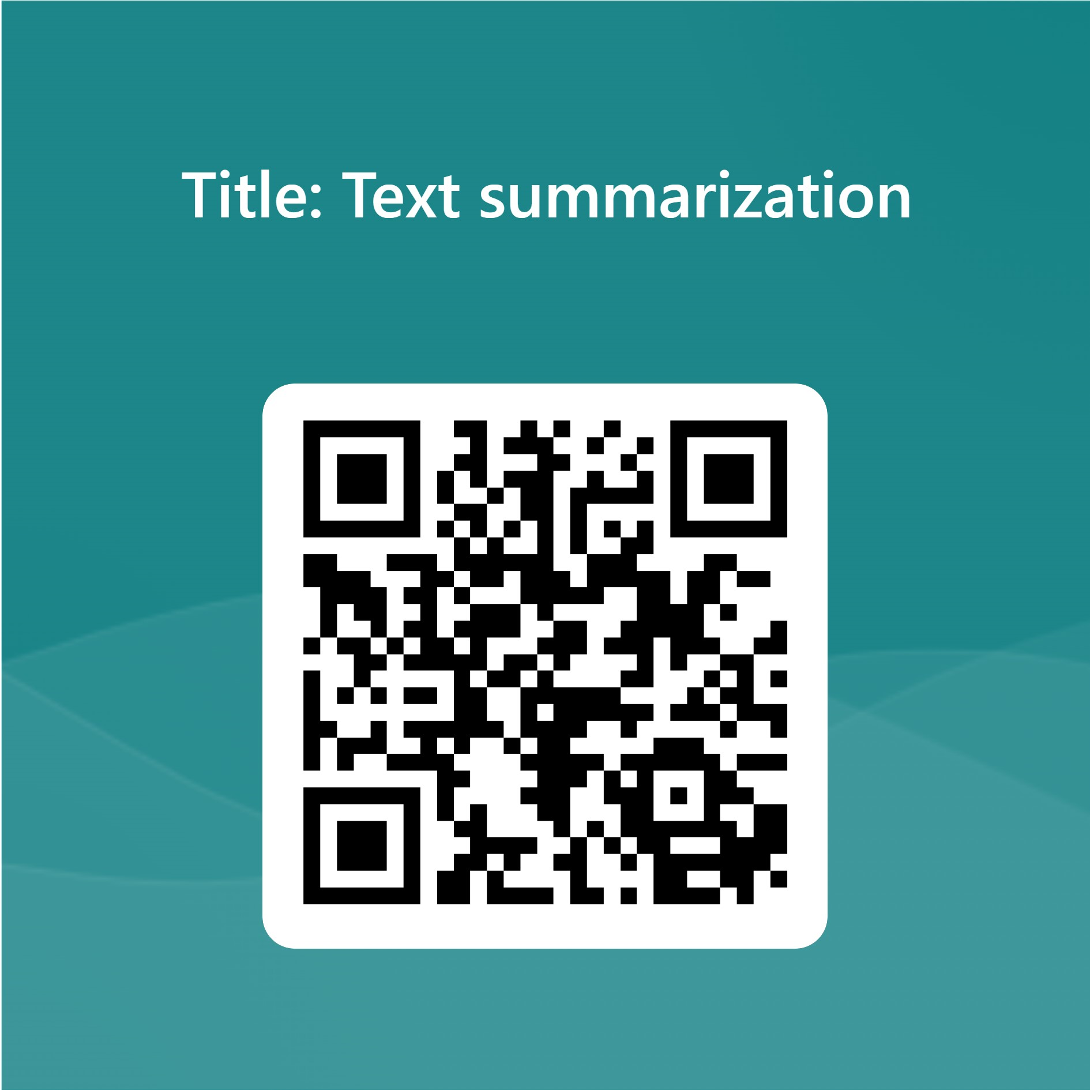
Text summarization, US20060206806A1
https://forms.office.com/e/aEyR2tampW
Abstract A method for summarizing text (20), comprising evaluating (24) selected words of the text according to predetermined criteria to provide word score values for each of the selected words. Thew method then provides for calculating (25) for each of the selected words a word weighted score that is dependent on the word score values and a number of occurrences of each of the selected words. Thereafter a step (26) of scoring sentences of the text to determine a sentence weighted score for the sentences is conducted. The sentence weighted score depends on sentence type and a combined word weighted score for words in the sentence. The method then provides for selecting (27) sentences to provide a summary of the text, the selecting being dependent on the sentence weighted score of the sentences. Link: https://patents.google.com/patent/US20060206806

Slide 6
Unsupervised ontology-based graph extraction from texts, US10169454B2
Abstract
A method for extracting a relations graph uses an ontology graph in which nodes represent entity classes or concepts and edges represent properties of the classes. A property is associated with a constraint which defines a range of values that can be taken without incurring a cost. Input text in which entity and concept mentions are identified is received. An optimal set of alignments between a subgraph of the ontology graph and the identified mentions is identified by optimizing a function of constraint costs incurred by the alignments and a distance measure computed over the set of alignments. The relations graph is generated, based on the optimal set of alignments. The relations graph represents a linked set of relations instantiating a subgraph of the ontology. The relations graph can include relations involving implicit mentions corresponding to subgraph nodes that are not aligned to any of the concept or entity mentions. Link: https://patents.google.com/patent/US10169454B2
https://forms.office.com/e/NjZuNSUHrk

Slide 7
Establishing user specified interaction modes in a question answering dialogue, US10831345B2
https://forms.office.com/e/VTZ3LY02Lm
Abstract
An approach is provided for automatically generating user-specific interaction modes for processing question and answers at the information handling system by receiving a question from a user, extracting user context parameters identifying a usage scenario for the user, identifying first input and output presentation modes for the user based on the extracted user context parameters, monitoring user interaction with the system in relation to the question, and adjusting the first input and output presentation modes based on the extracted user context parameters and detected user interaction with the system. Link: https://patents.google.com/patent/US10831345B2

Slide 8
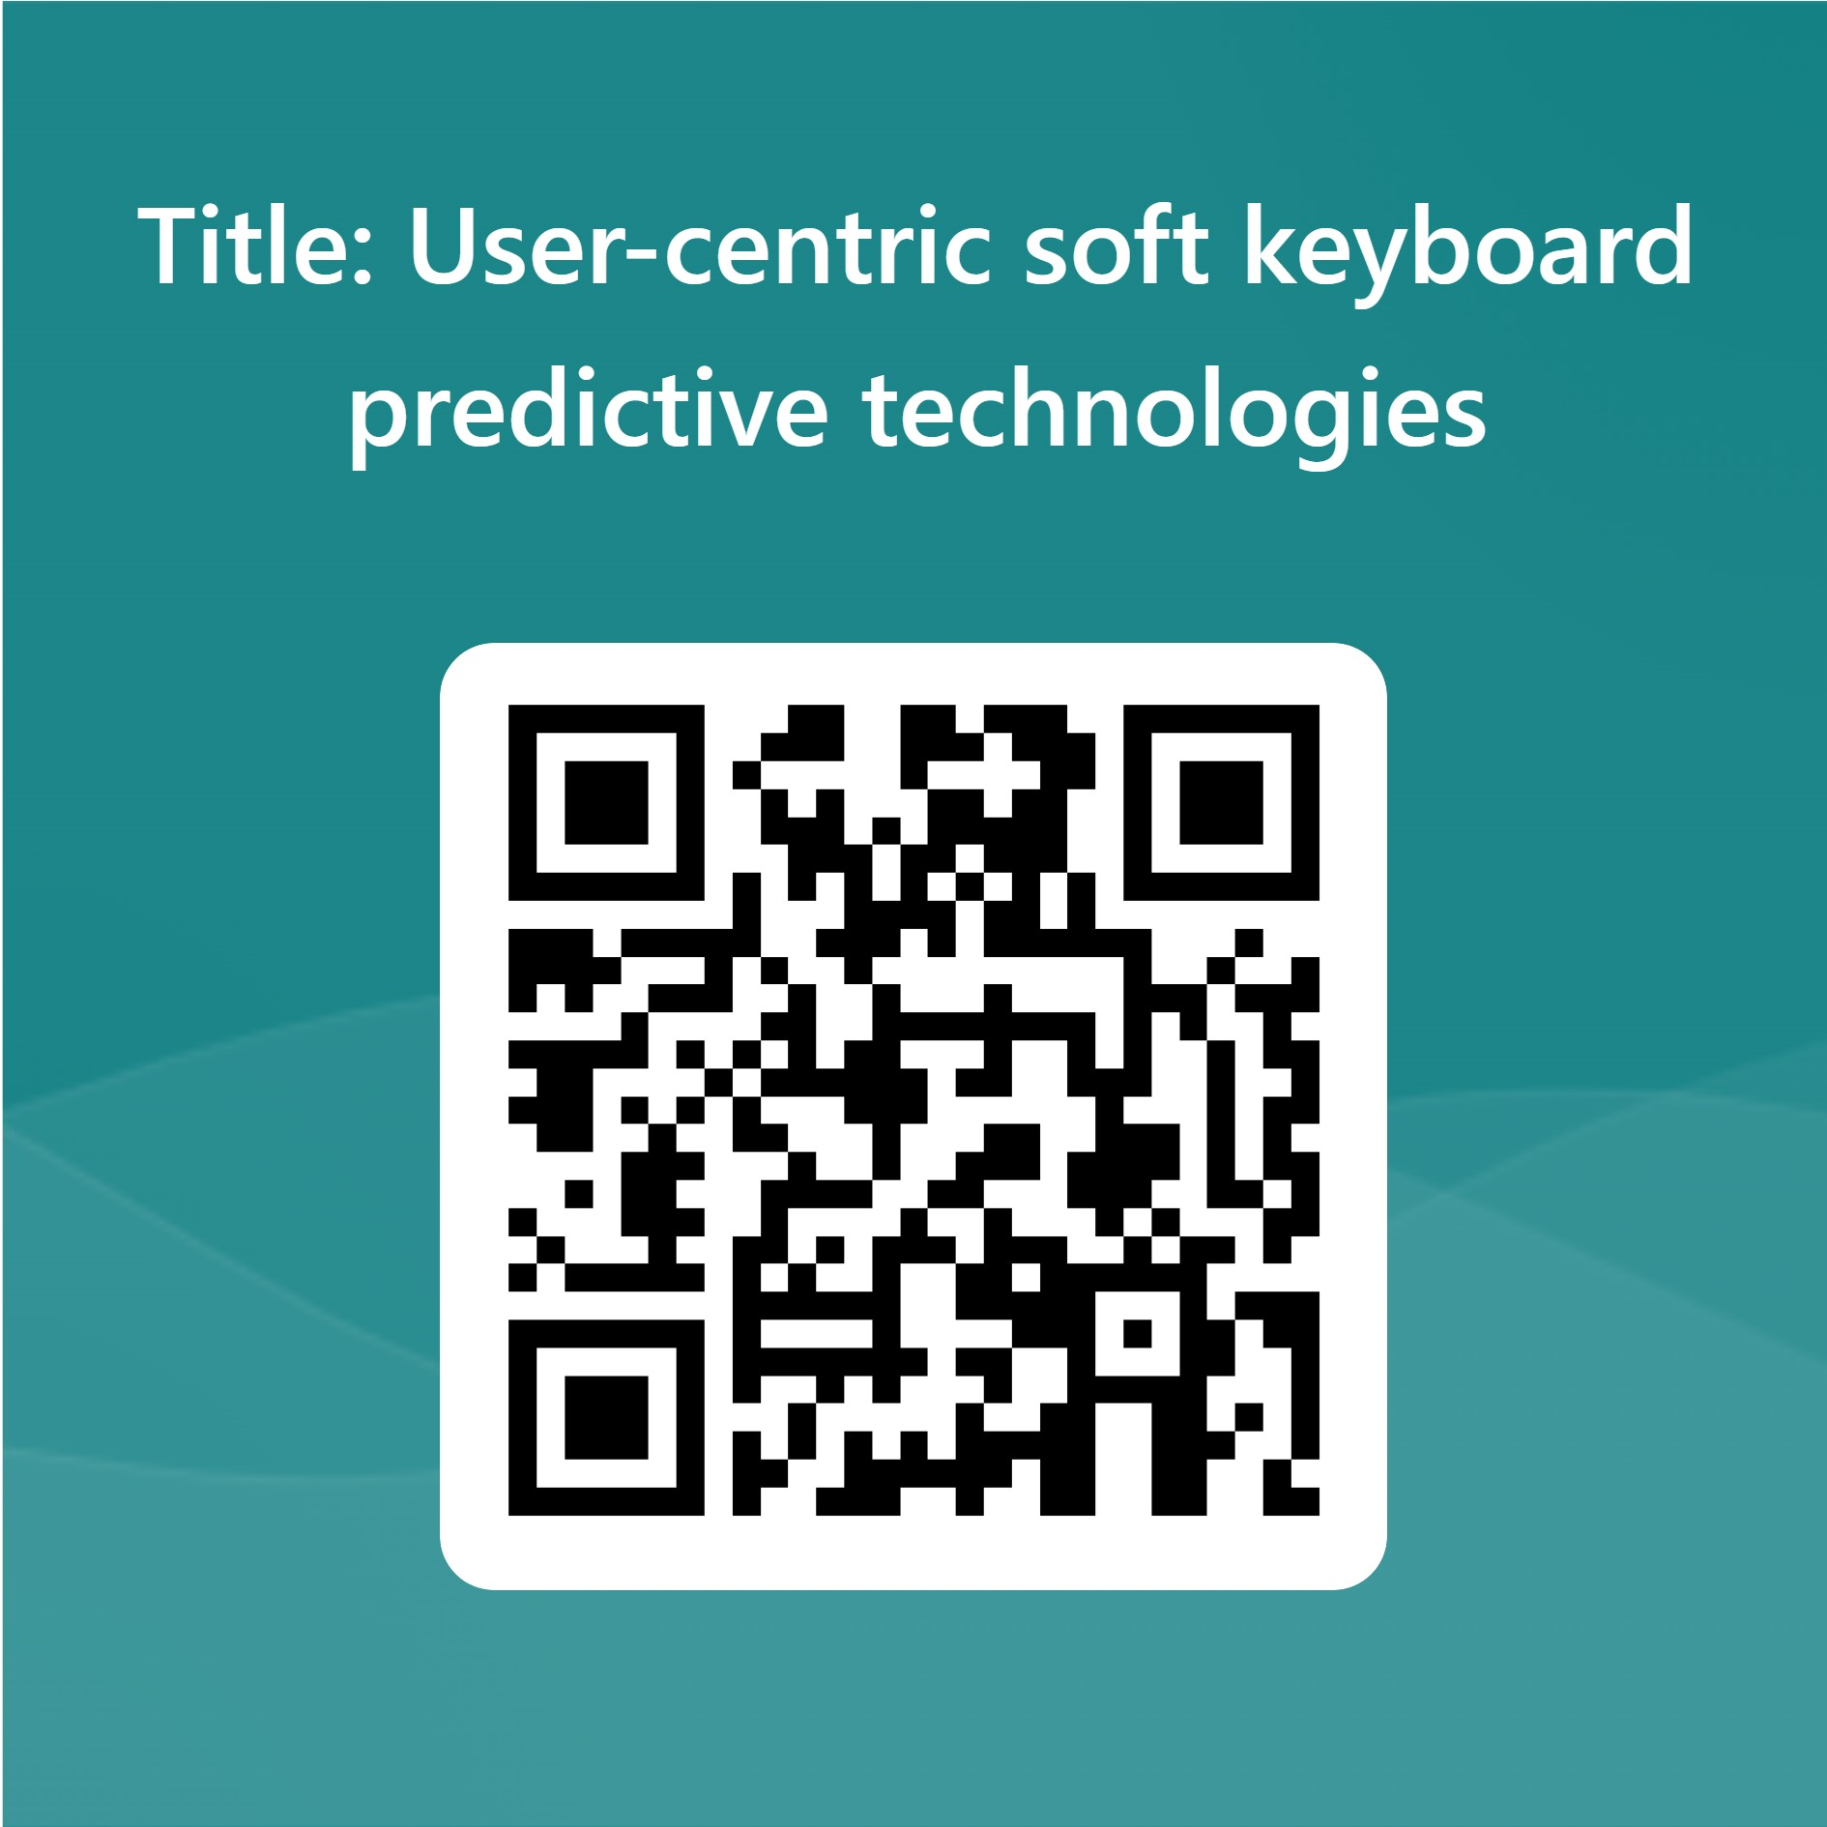
User-centric soft keyboard predictive technologies US10156981B2
https://forms.office.com/e/pjDwaCu85f
Abstract
An apparatus and method are disclosed for providing feedback and guidance to touch screen device users to improve text entry user experience and performance by generating input history data including character probabilities, word probabilities, and touch models. According to one embodiment, a method comprises receiving first input data, automatically learning user tendencies based on the first input data to generate input history data, receiving second input data, and generating auto-corrections or suggestion candidates for one or more words of the second input data based on the input history data. The user can then select one of the suggestion candidates to replace a selected word with the selected suggestion candidate. Link: https://patents.google.com/patent/US10156981B2

Slide 9
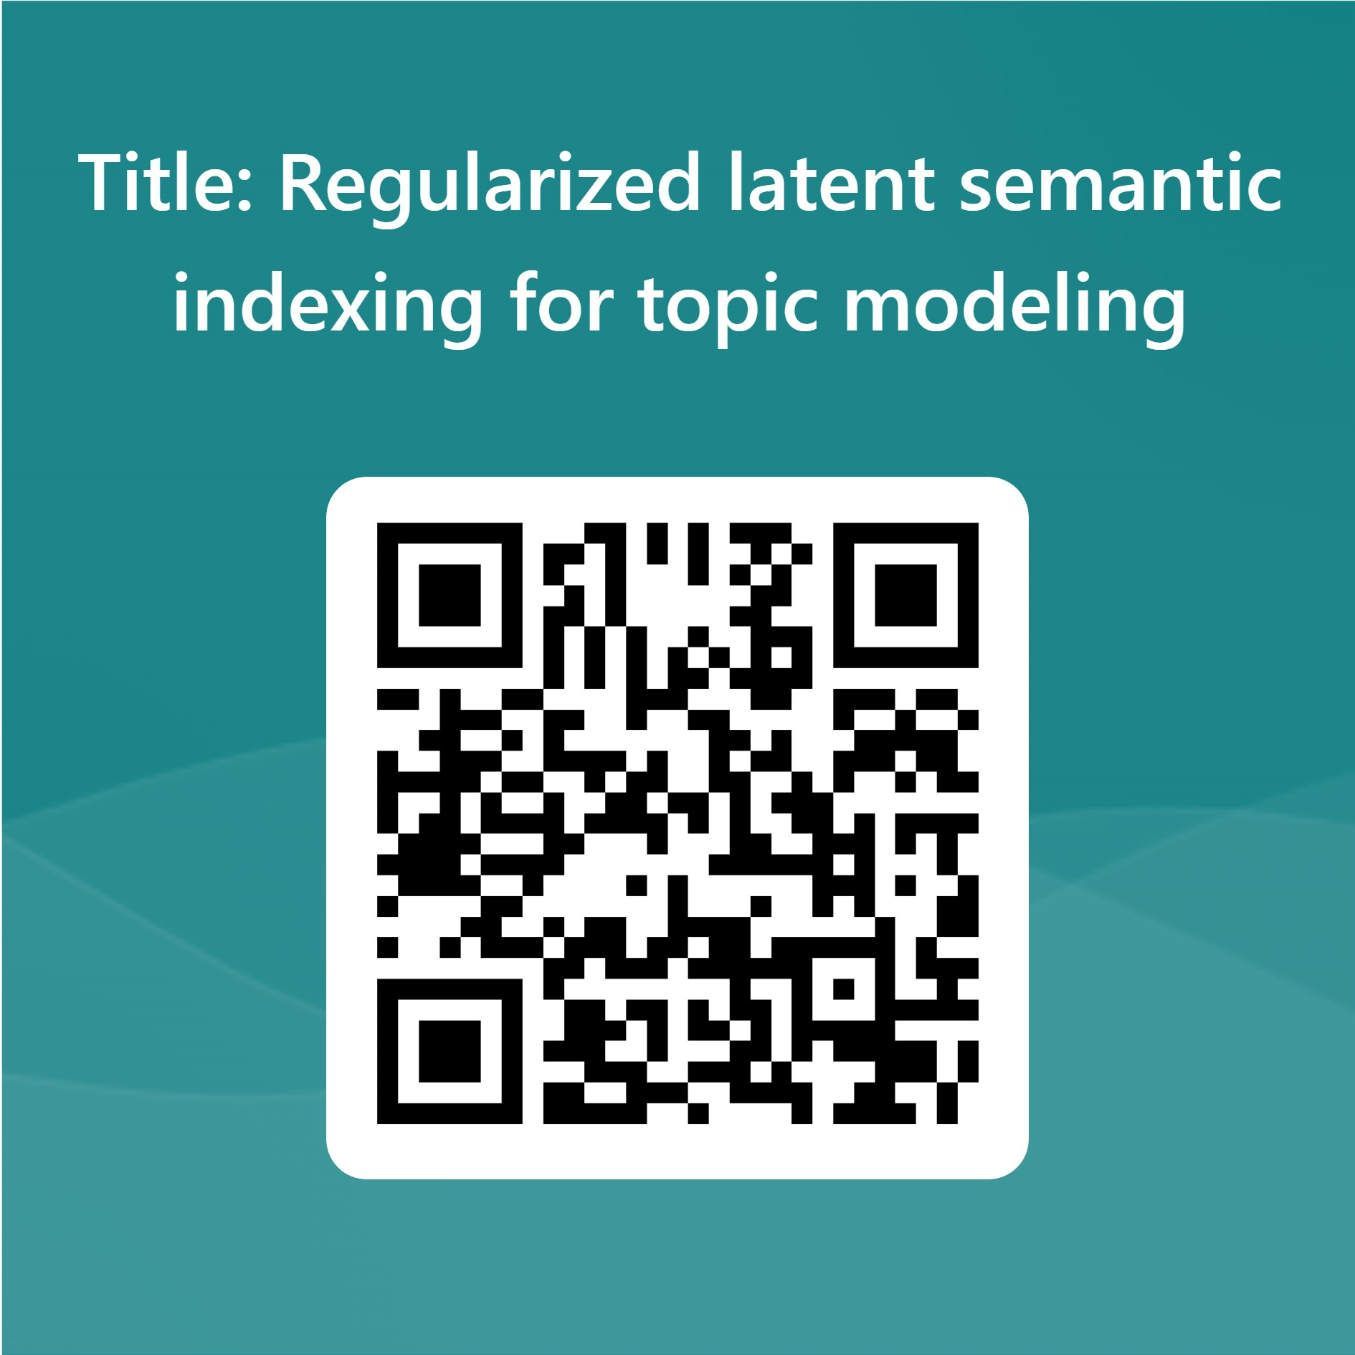
Title: Regularized latent semantic indexing for topic modeling, US8533195B2
Abstract
Electronic documents are retrieved from a database and/or from a network of servers. The documents are topic modeled in accordance with a Regularized Latent Semantic Indexing approach. The Regularized Latent Semantic Indexing approach may allow an equation involving an approximation of a term-document matrix to be solved in parallel by multiple calculating units. The equation may include terms that are regularized via either l1 norm and/or via l2 norm. The Regularized Latent Semantic Indexing approach may be applied to a set, or a fixed number, of documents such that the set of documents is topic modeled. Alternatively, the Regularized Latent Semantic Indexing approach may be applied to a variable number of documents such that, over time, the variable of number of documents is topic modeled. Link: https://patents.google.com/patent/US8533195B2
https://forms.office.com/e/6DEBXDUPGz

Slide 10
Thank you for participating!
Developing search technology is a skill,
but designing search technology is an art.
Spin-off from TU Wien since 2019
https://informatics.tuwien.ac.at/knowledge-transfer/spin-offs/

